Slide 1
Safety and security report: July 2019
Forest Park Southeast, Botanical Heights, Central West End, Medical Campus

Slide 2
Summary Notes: FPSE July 2019
32 Total Crimes
39.13% increase compared to July 2018 (23 crimes)
Decreased: assault
Increased: arson, auto theft, burglary, larceny
No change: rape, robbery
4 crimes against persons (2 assaults, 2 robberies)
33.33% decrease compared to July 2018 (6 crimes)
Crime occurred most frequently on Sundays, Fridays, and Saturdays.
146 total crimes so far in 2019
20.66% increase compared to this point in 2018 (121 crimes)
Decreased: assault, burglary, homicide, rape
Increased: arson, auto theft, larceny, robbery
No change:
29 crimes against persons so far in 2019
30.95% decrease compared to this point in 2018 (36 crimes)

Slide 3
Forest Park Southeast: July 2019

Slide 4
Comparing 2018 and 2019: FPSE

Slide 5
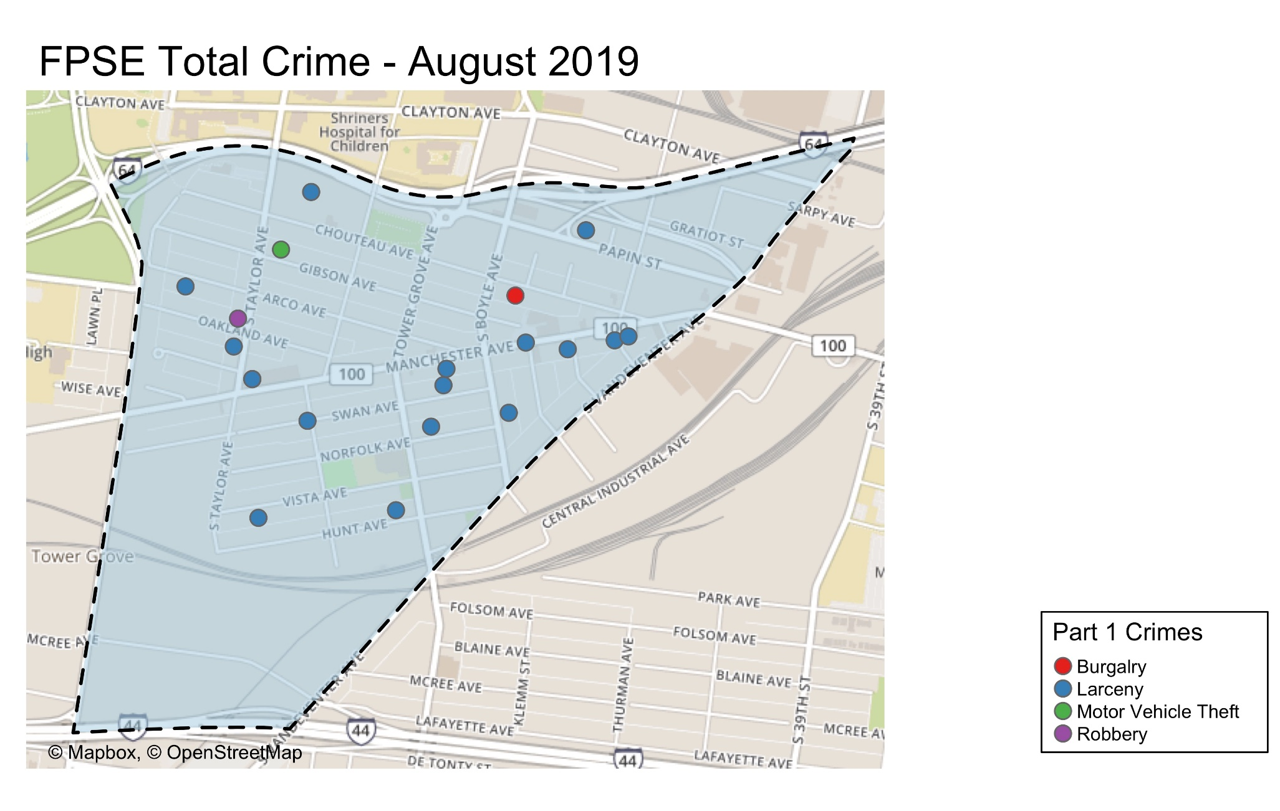

Slide 6
Appendix 1 Links
FPSE Day/Night
FPSE Crimes Against Persons
FPSE Establishment
FPSE Density Map
FPSE Larceny Breakdown
FPSE Inside/ Outside Larcenies
FSPE Crime by Day of Week
FPSE Crimes and Calls for Service by Time of Day
FPSE Crime by Day and Time Frame
FPSE Crime by Category and Day
FPSE Crime by Category and Time of Day

Slide 7
Summary Notes: Botanical Heights July 2019
10 Total Crimes
25.00% increase compared to July 2018 (8 crimes)
Decreased: auto theft
Increased: larceny
No change: arson, assault, burglary, homicide, rape, robbery
0 crime against persons
No change compared to July 2018 (0 crimes)
Crime occurred most frequently on Saturdays.
52 total crimes so far in 2019
16.13% decrease compared to this point in 2018 (62 crimes)
Decreased: auto theft, burglary, larceny
Increased: robbery
No change: arson, assault, homicide, rape
11 crimes against persons so far this year
37.50% increase compared to this point in 2018 (8 crimes)

Slide 8
Botanical Heights: July 2019

Slide 9
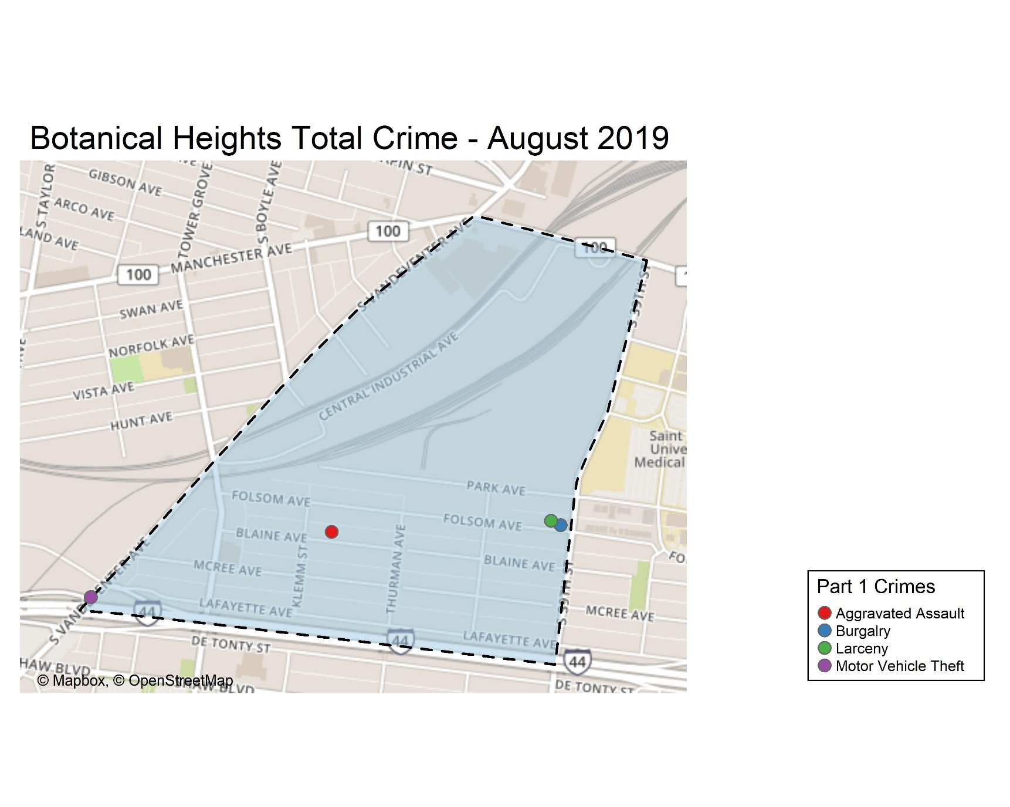

Slide 10
Comparing 2018 and 2019: Botanical Heights

Slide 11
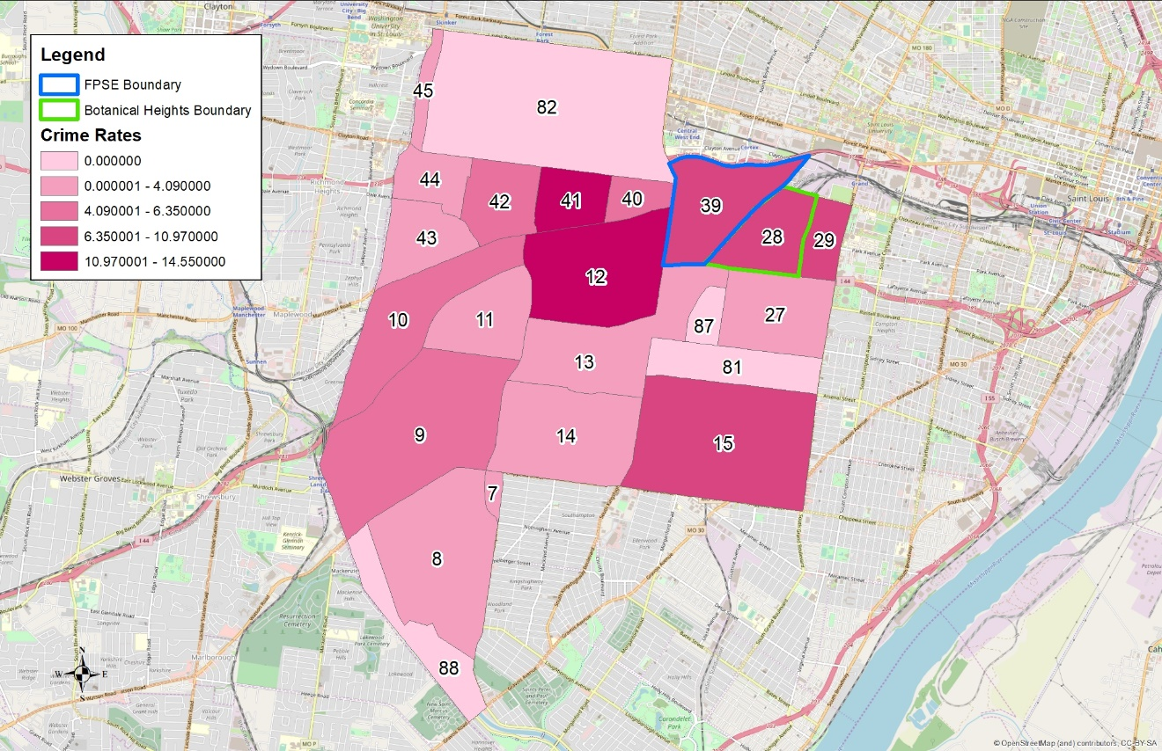
District 2 Density Map: July 2019
Notes:
Crime rates are crimes per 1000 people
South Hampton neighborhood is split between District 1 and District 2.

Slide 12
District 2 Density Map Explanation
District 2
There are 23 neighborhoods in District 2. The South Hampton neighborhood is split between District 2 and District 1
The minimum number of crimes in one neighborhood was 1 (Kings Oak, Tower Grove Park, The Botanical Garden, and Willmore Park).
The maximum number of crimes in one neighborhood was 105 (Tower Grove South).
The mean number of crimes per neighborhood was 18.26.
Crime Rate
The crime rate was calculated per 1,000 people using 2010 census data. Crime rates were not calculated for Forest Park, Tower Grove Park, Willmore Park or the Botanical Gardens due to negligible populations.
The minimum crime rate was 2.03 crimes per 1,000 people (South Hampton).
The maximum crime rate was 14.55 crimes per 1,000 people (The Hill).
The mean crime rate was 6.15 crimes per 1,000 people (this mean rate does not include Forest Park, Tower Grove Park, Willmore Park or the Botanical Gardens due to their negligible populations).
*Numbers in District breakdown include reclassified crimes from previous months.

Slide 13
Summary Notes: CWE July 2019
106 Total Crimes
33.75% decrease compared to July 2018 (160 crimes)
Decreased: auto theft, larceny
Increased: burglary, robbery
No change: arson, assault, homicide, rape
13 crimes against persons (8 assaults, 1 rape, 4 robberies)
8.33% increase compared to July 2018 (12 crimes)
Crime occurred most frequently on Wednesdays.
666 total crimes so far in 2019
6.59% decrease compared to this point in 2018 (713 crimes)
Decreased: homicide, larceny, robbery
Increased: assault, auto theft, burglary
No change: arson, rape
102 crimes against persons so far in 2019
18.60% increase compared to this point in 2018 (86 crimes)

Slide 14
Central West End: July 2019

Slide 15
CWE: Comparing 2018 and 2019

Slide 16
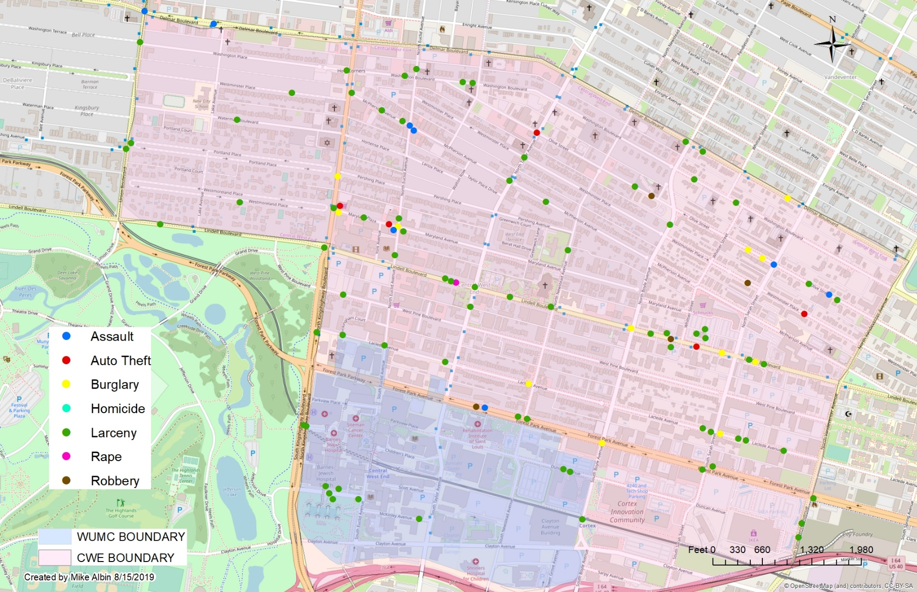
Central West End Crimes: July 2019

Slide 17
Appendix 2 Links
CWE Day/ Night Crimes
CWE Crimes Against Persons
CWE Density Map
CWE Larceny Breakdown
CWE Inside/ Outside Larcenies
CWE Crime by Day of Week
CWE Crime and Calls for Service by Time of Day
CWE Crime by Day and Time Frame
CWE Crime by Category and Time of Day
CWE Crime by Category and Day

Slide 18
Washington University Medical Campus: July 2019
10 Total Crimes
150.00% increase compared to July 2018 (4 crimes).
Decreased: assault, rape
Increased: larceny
No change: arson, auto theft, burglary, homicide, robbery
0 crimes against persons
100% decrease compared to July 2018 (2 crimes)
81 total crimes so far in 2019
24.62% increase compared to this point in 2018 (65 crimes)
Decreased: homicide, rape
Increased: assault, auto theft, larceny
No change: arson, burglary, robbery

Slide 19
WUMC Campus: Comparing 2018 and 2019

Slide 20
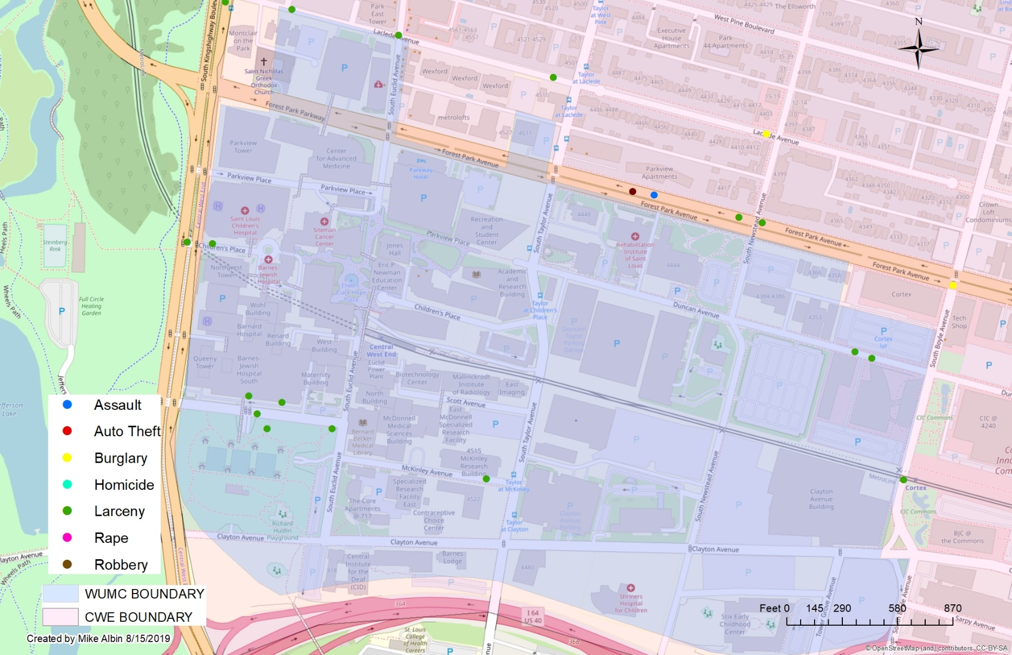
WUMC Campus Crimes: July 2019

Slide 21
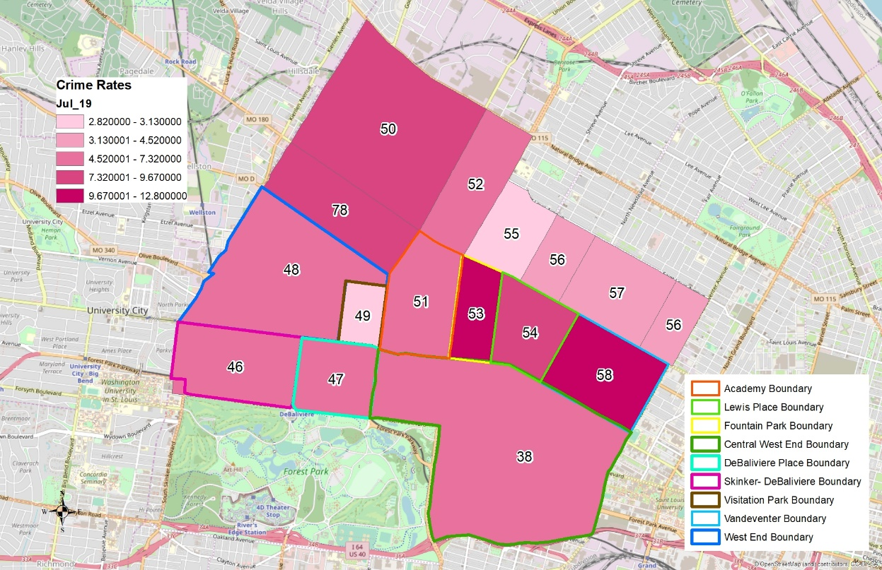
District 5 Density Map: July 2019
*Kingsway East and The Greater Ville neighborhoods are split between District 5 and District 6.

Slide 22
District 5 Density Map Explanation
District 5 Map
There are 15 neighborhoods in District 5.
The minimum number of crimes in one neighborhood was 3 (Visitation Park).
The maximum number of crimes in one neighborhood was 106 (Central West End).
The mean number of crimes for the district was 28.27.
Crime Rate
The crime rate was calculated using the population data from the 2010 census data.
The minimum crime rate was 3.13 crimes per 1,000 people (Visitation Park).
The maximum crime rate was 12.80 crimes per 1,000 people (Fountain Park).
The mean crime rate for the district was 7.00 crimes per 1,000 people.
*Numbers in District breakdown include reclassified crimes from previous months.

Slide 23
Appendix 1
Forest Park Southeast Neighborhood Detail

Slide 24
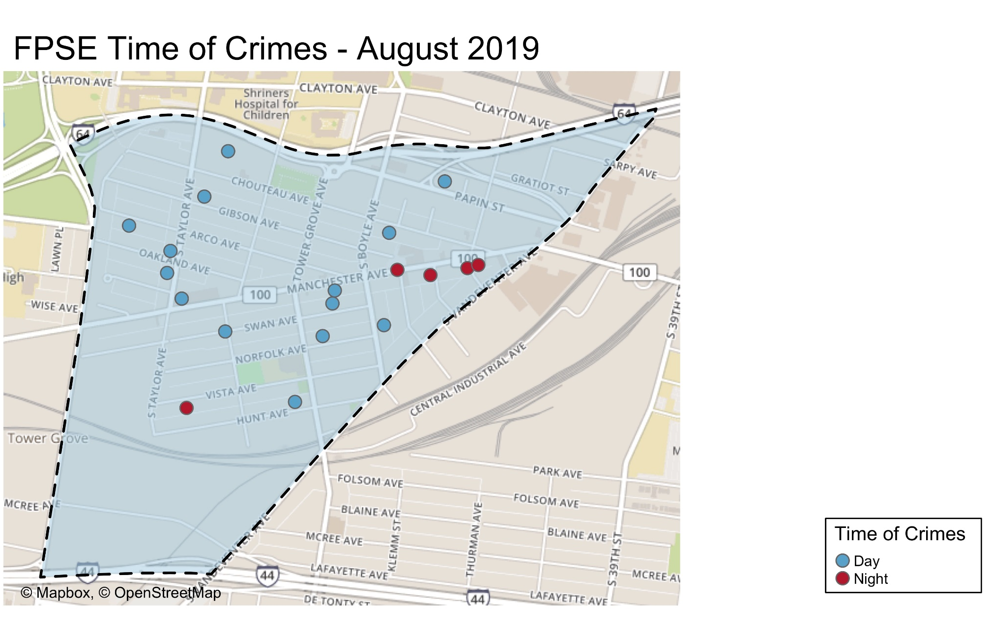

Slide 25
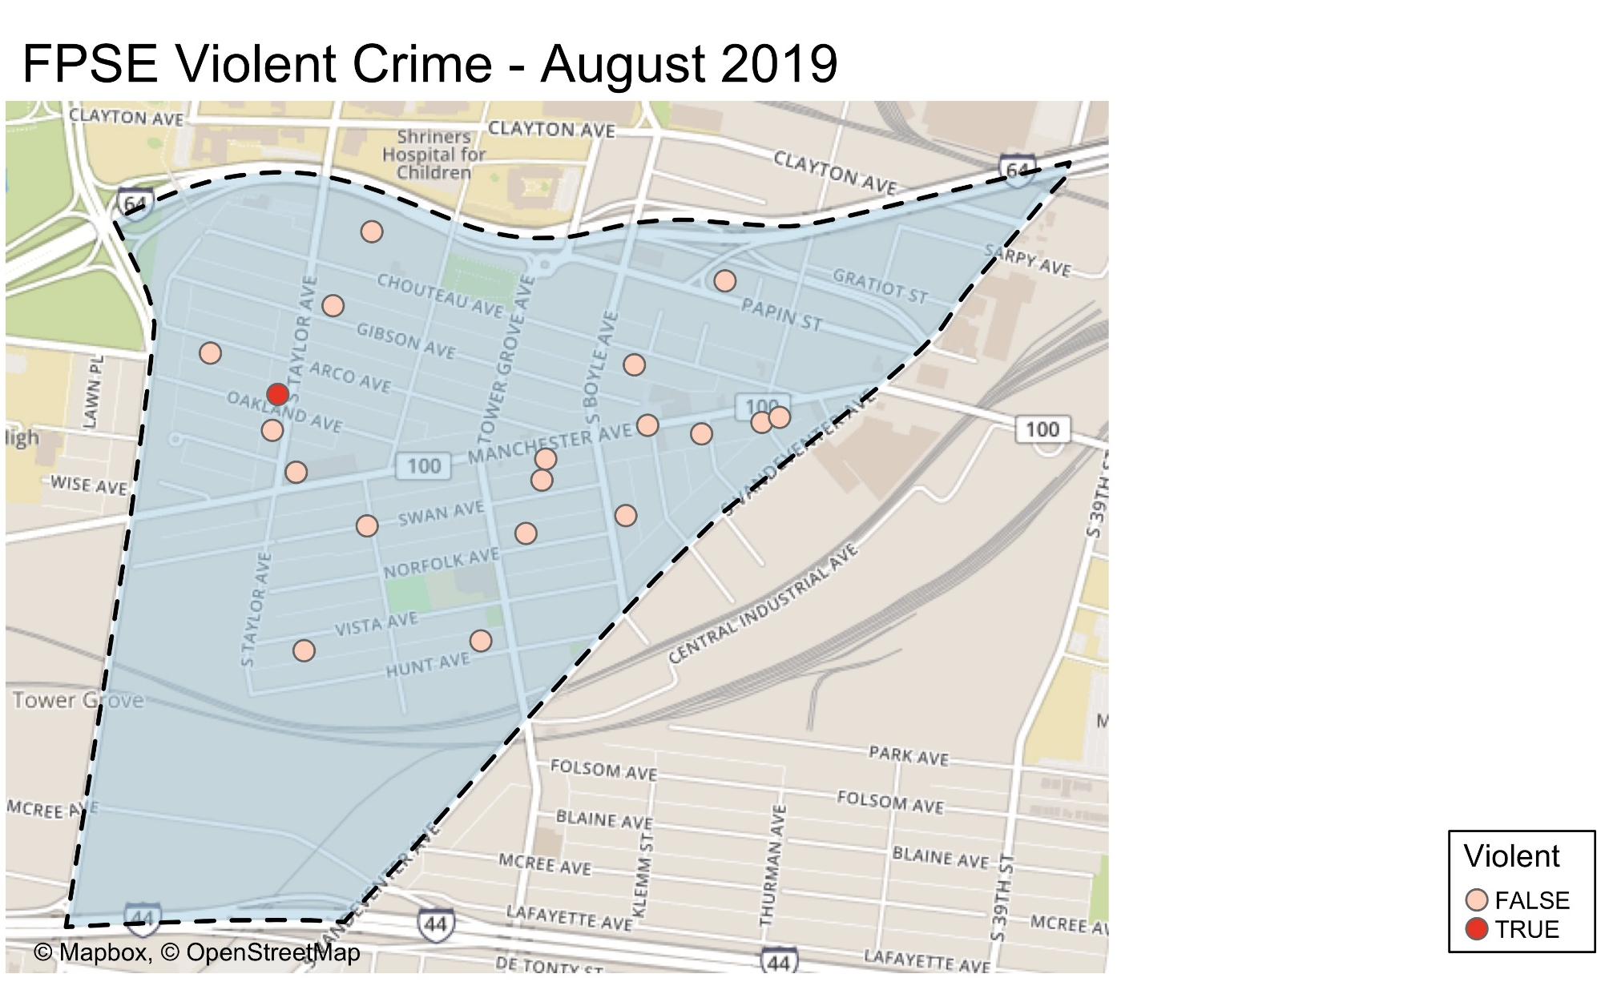

Slide 26
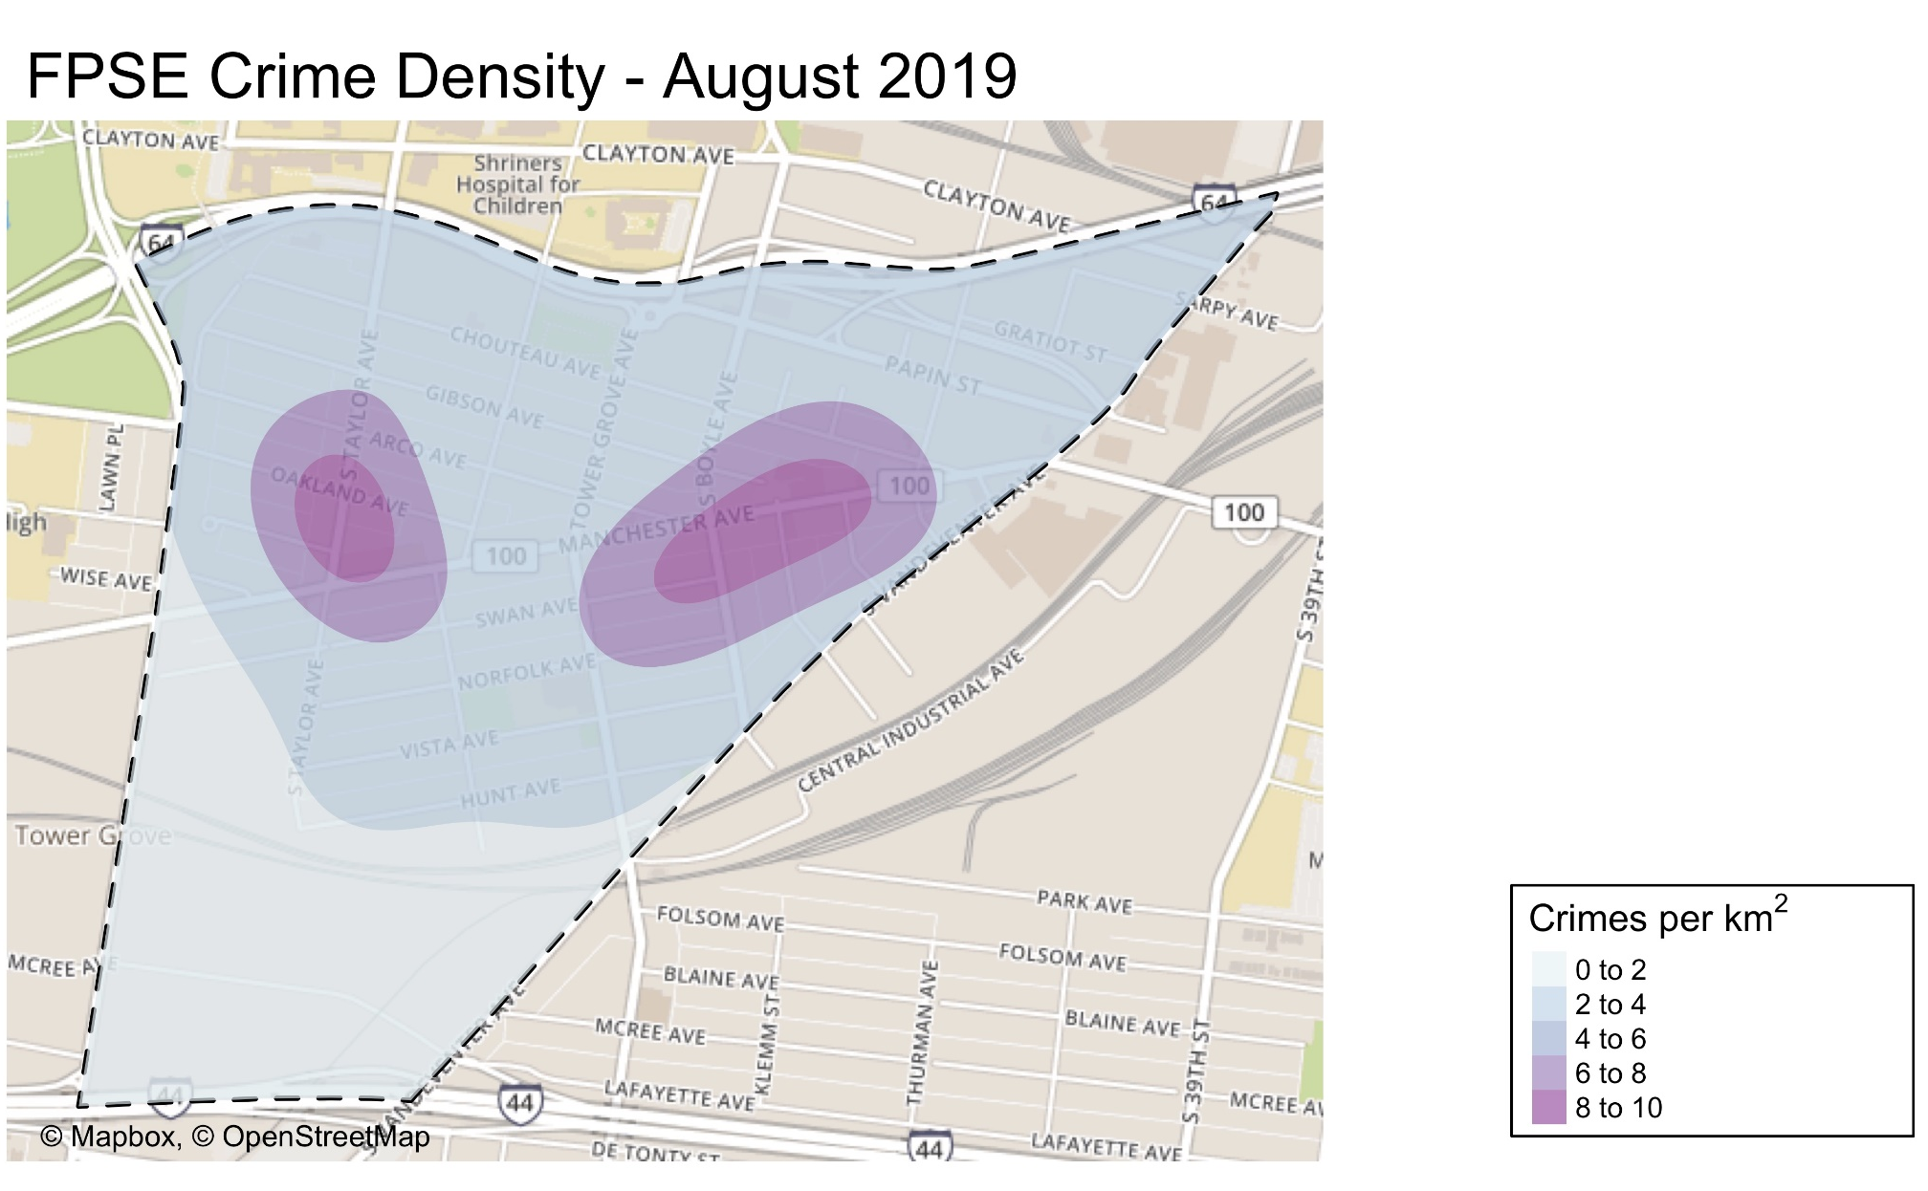

Slide 27
FPSE: July 2019 Larceny Breakdown

Slide 28
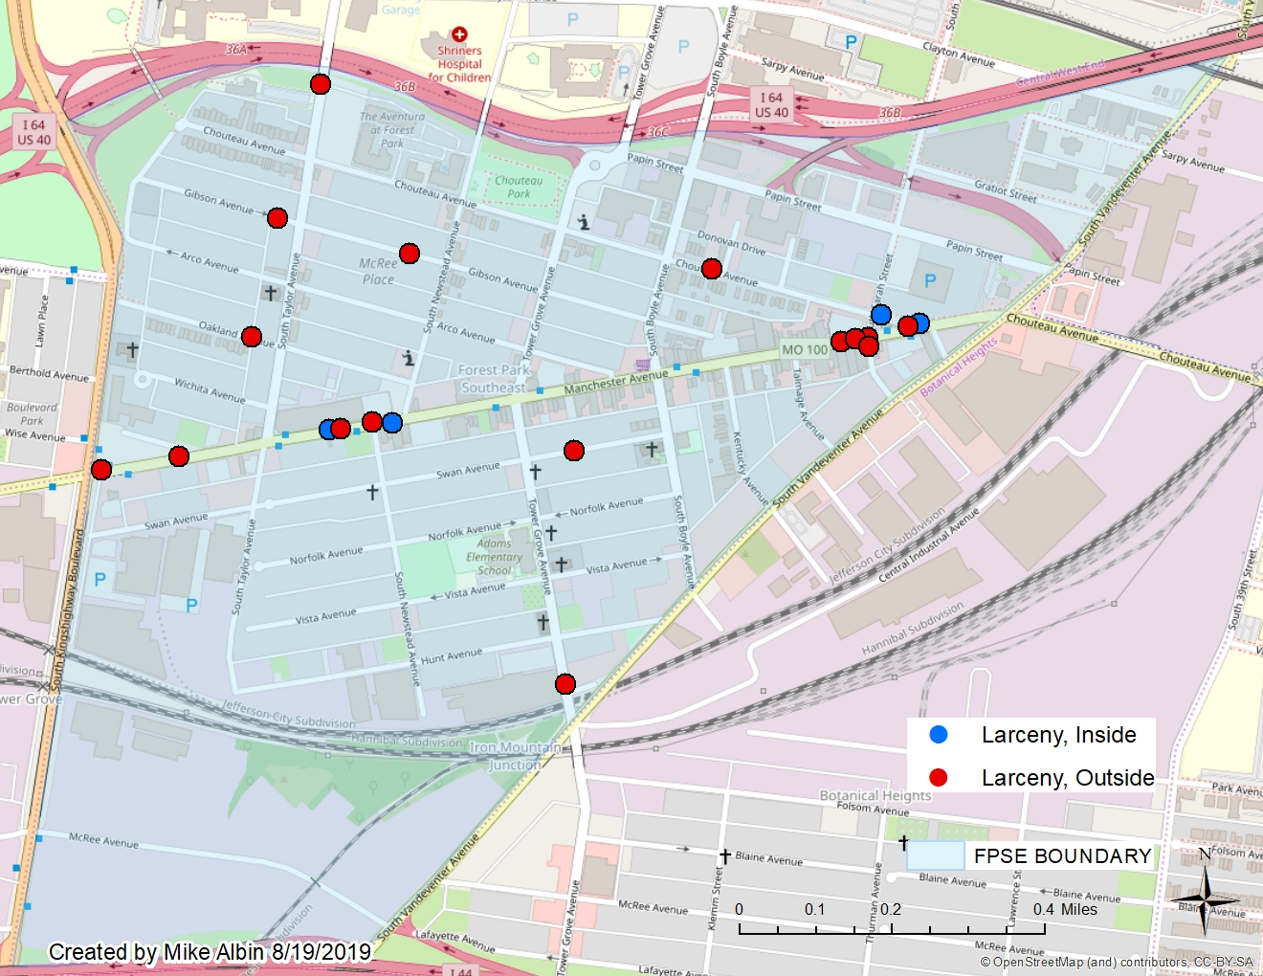
FPSE Inside/Outside Larcenies

Slide 34
Appendix 2
Central West End Detail

Slide 35
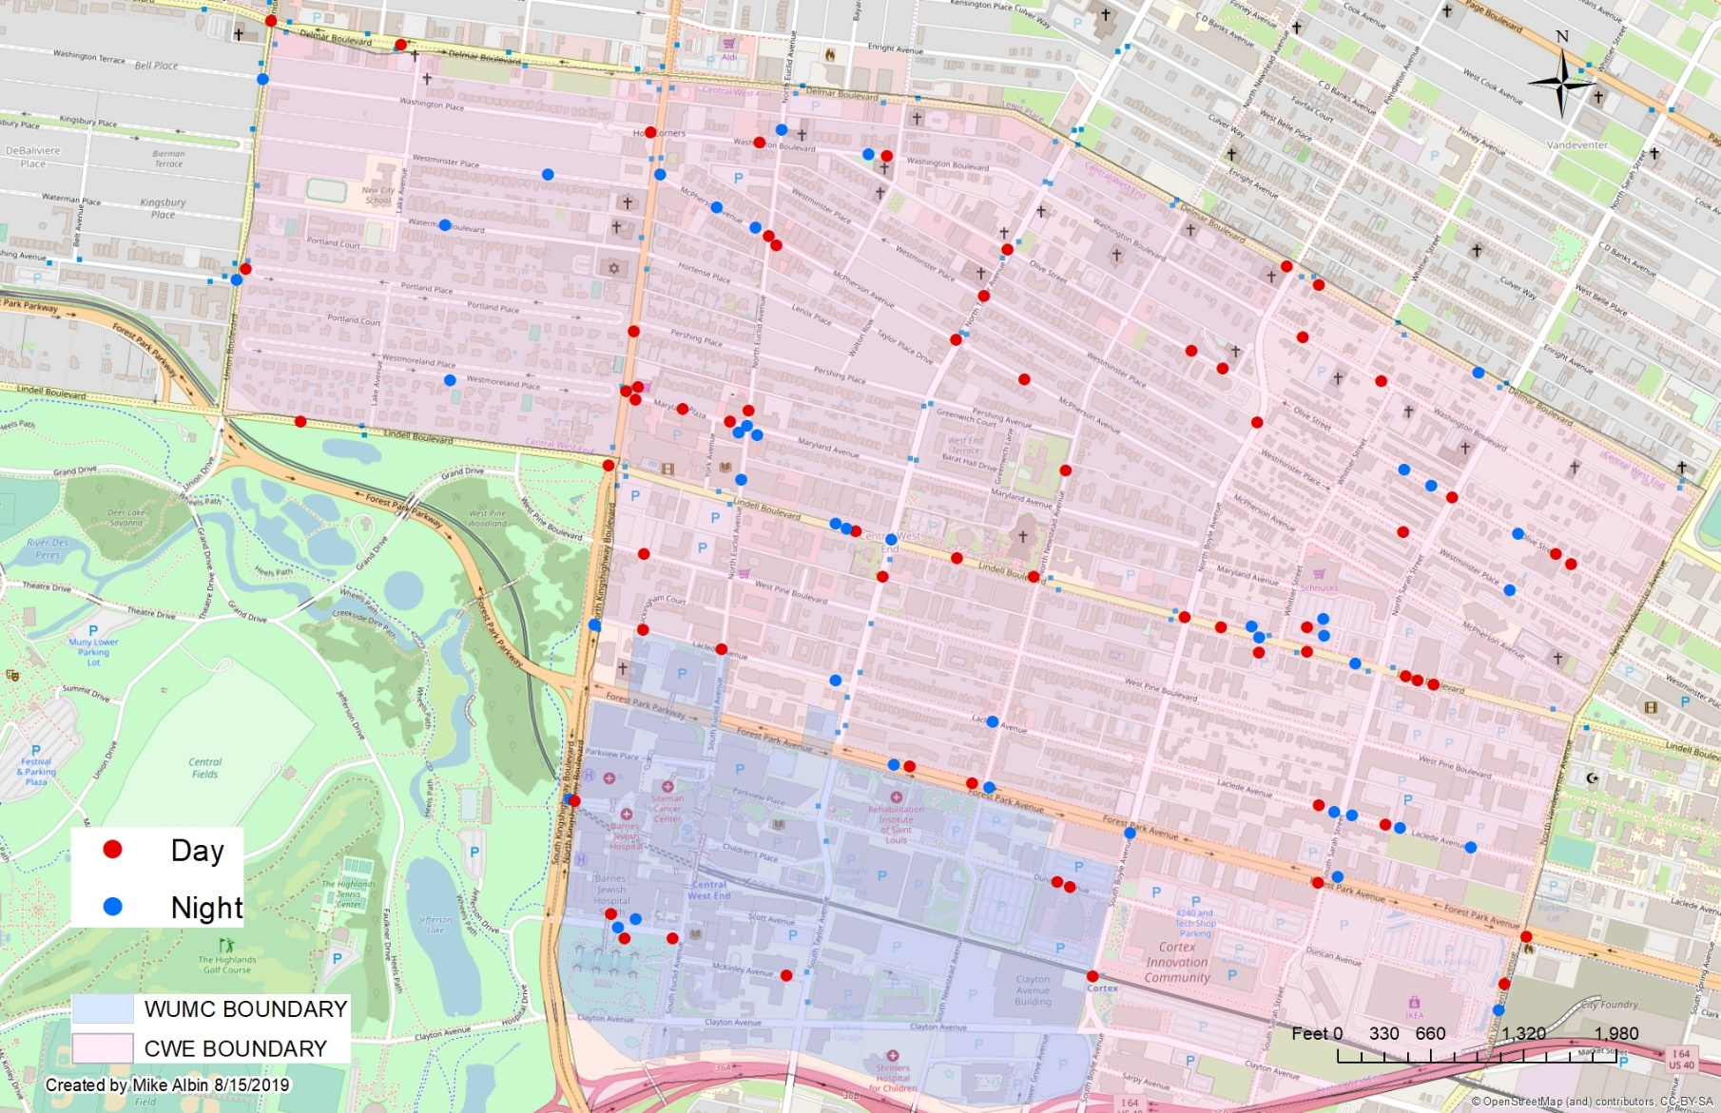
CWE Day/Night Crimes

Slide 36
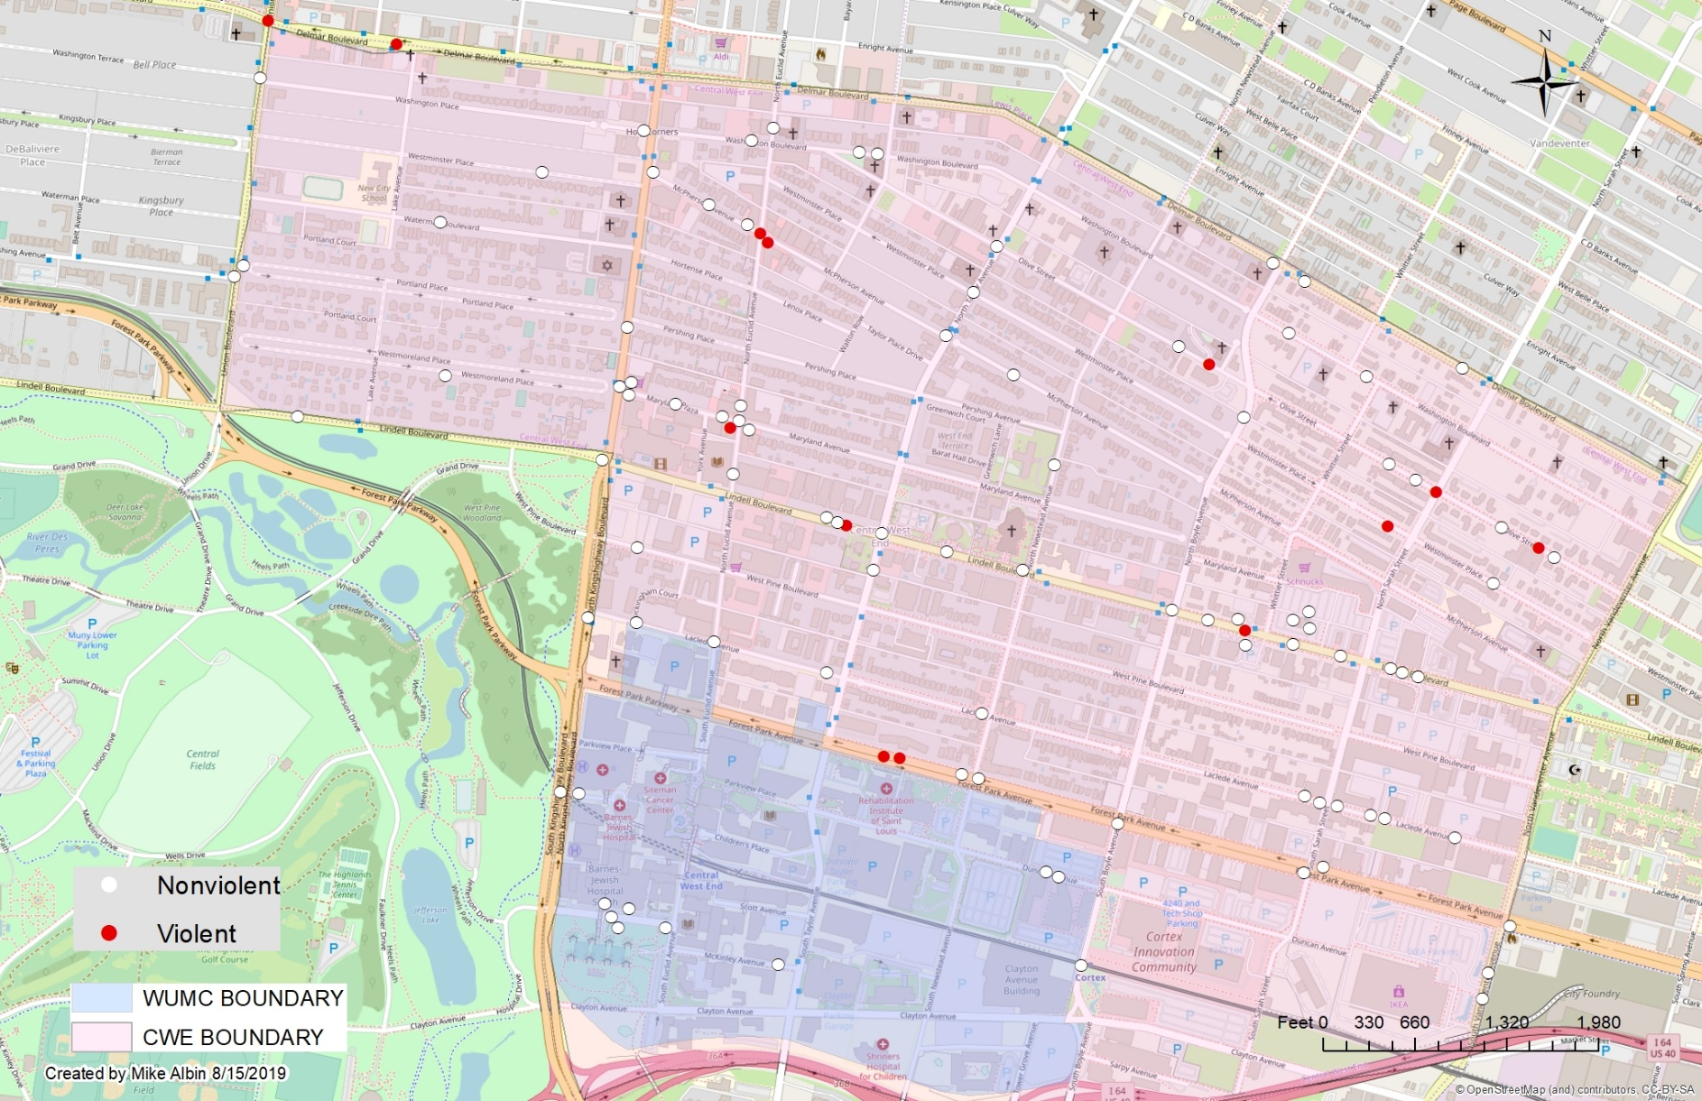
CWE Crimes Against Persons

Slide 37
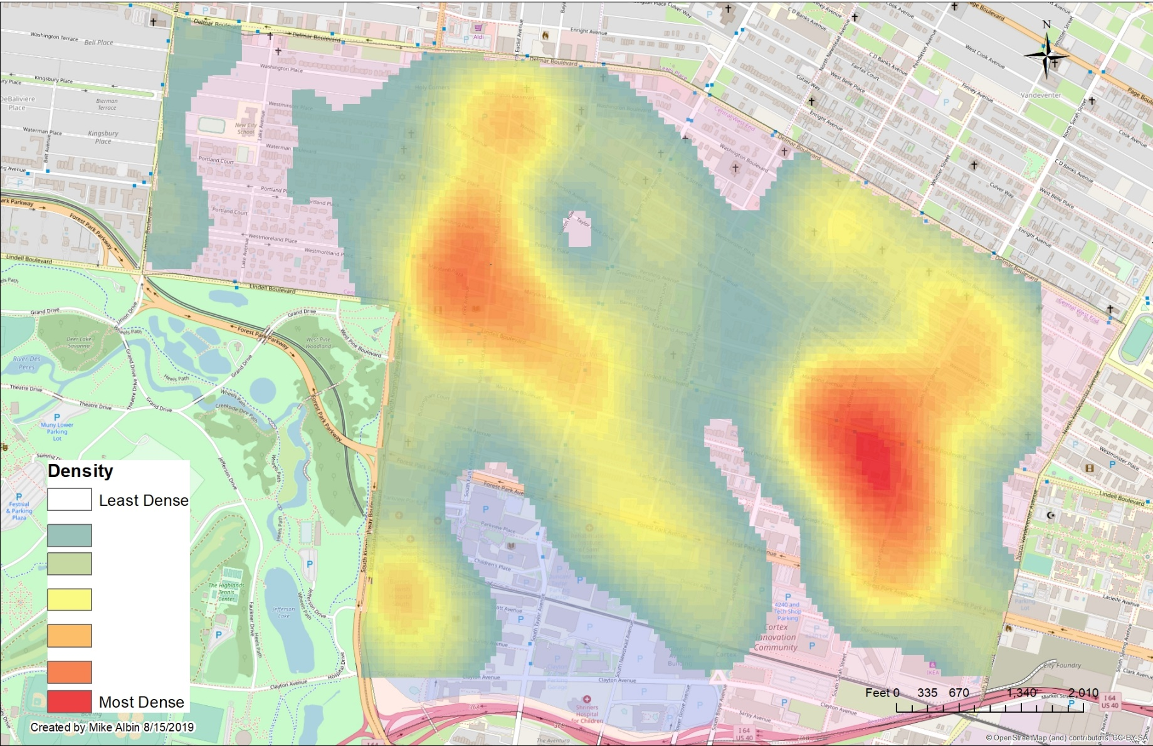
CWE Crime Density Map

Slide 38
CWE: July 2019 Larceny Breakdown

Slide 39

CWE Inside/Outside Larcenies

